Slide 1

Large Binocular Telescope
Interferometer (LBTI)
Software Documentation
Project
Zachary Kirch
University of Arizona Undergraduate Student
Electrical and Computer Engineering, Optical Sciences and Engineering, Mathematics
Mentors:
Steve Ertel (Leading Instrument Scientist), Paul Grenz (Head of Software)

Slide 2
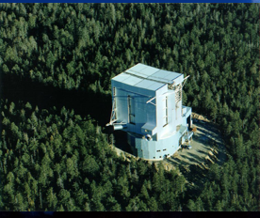
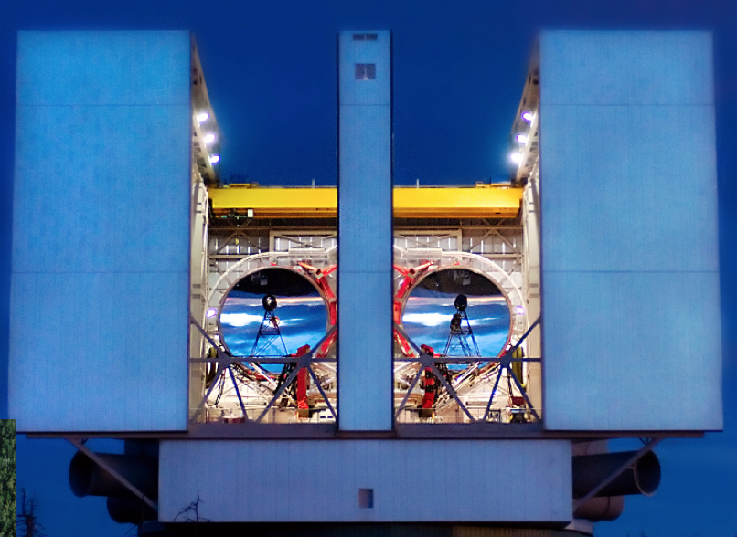
Really Big Telescope!

Slide 3
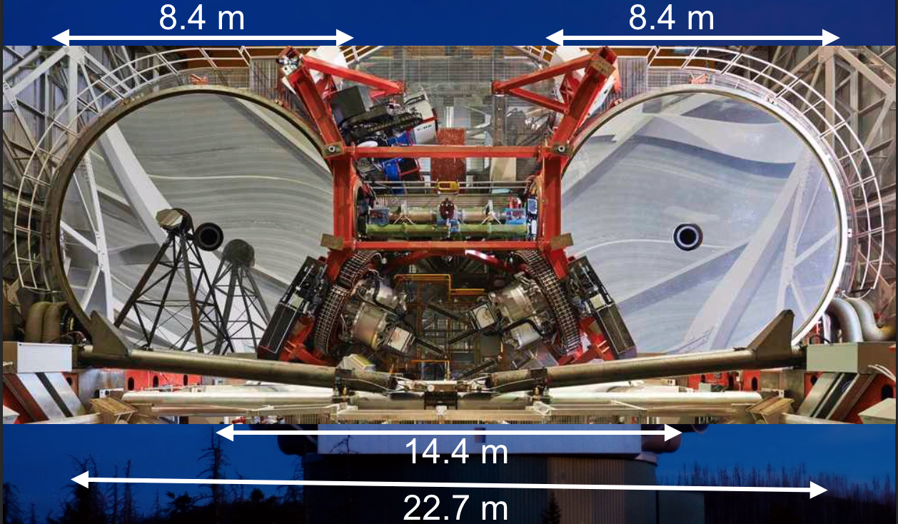
LBT/I Layout

Slide 4


LBTI Purpose

Slide 5
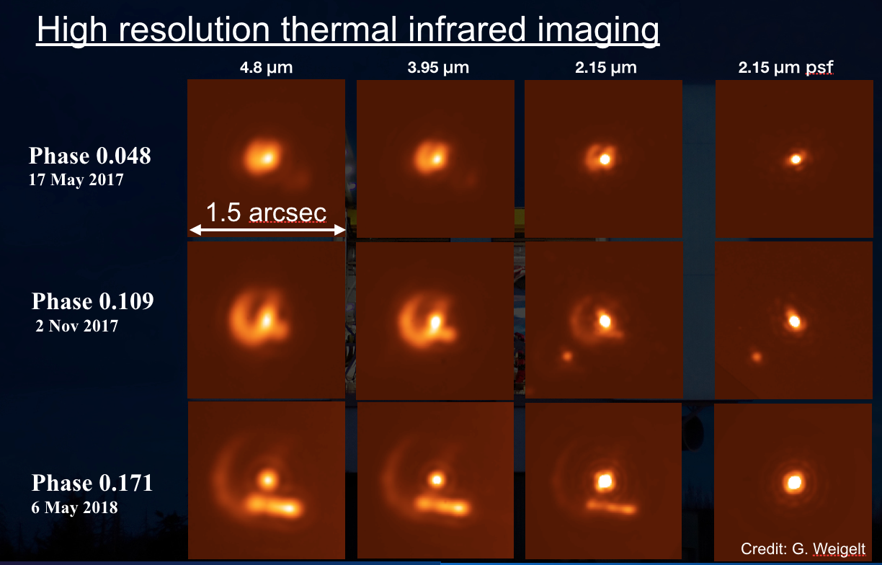
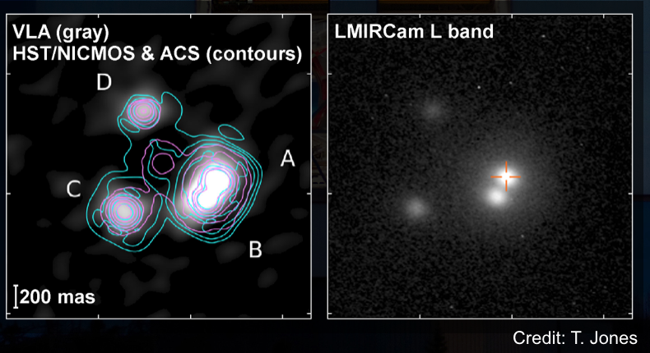
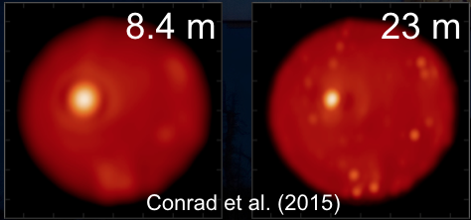
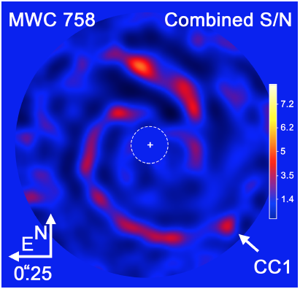
Other cool science LBTI can do

Slide 6
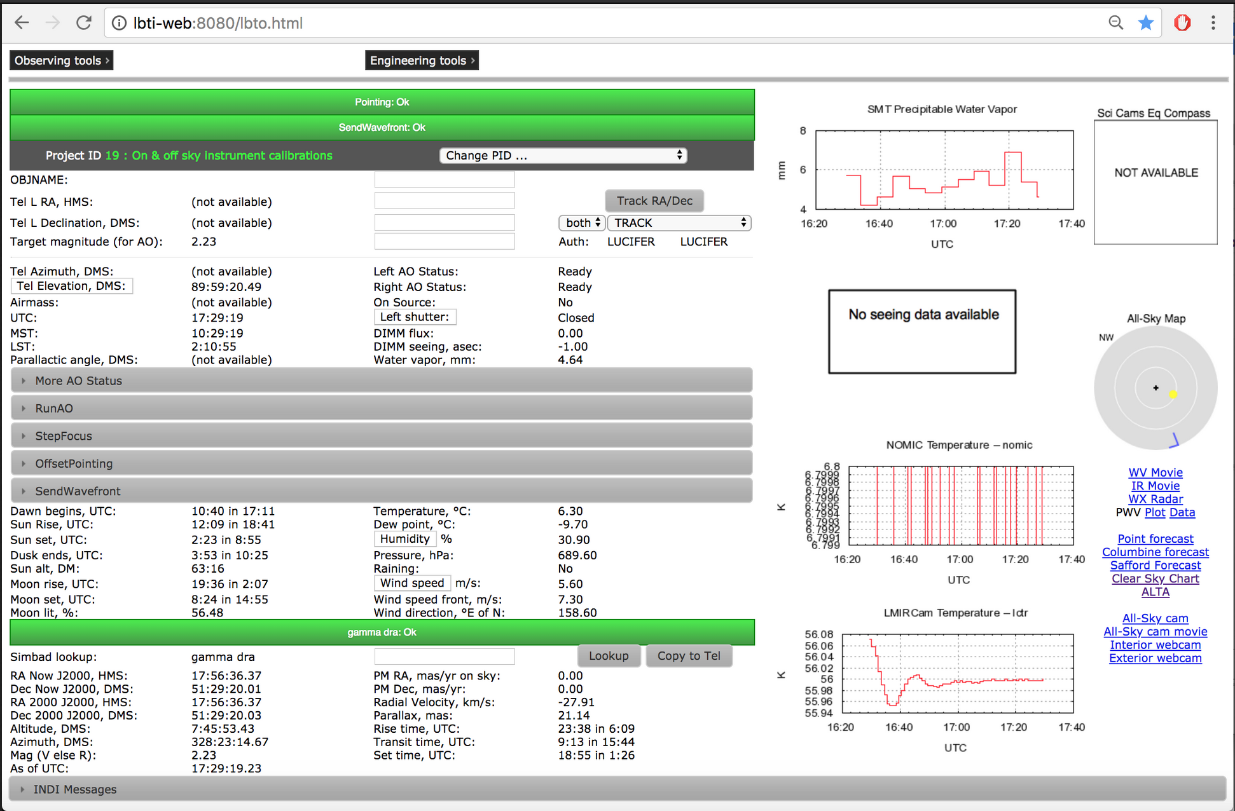
LBTI Website

Slide 7
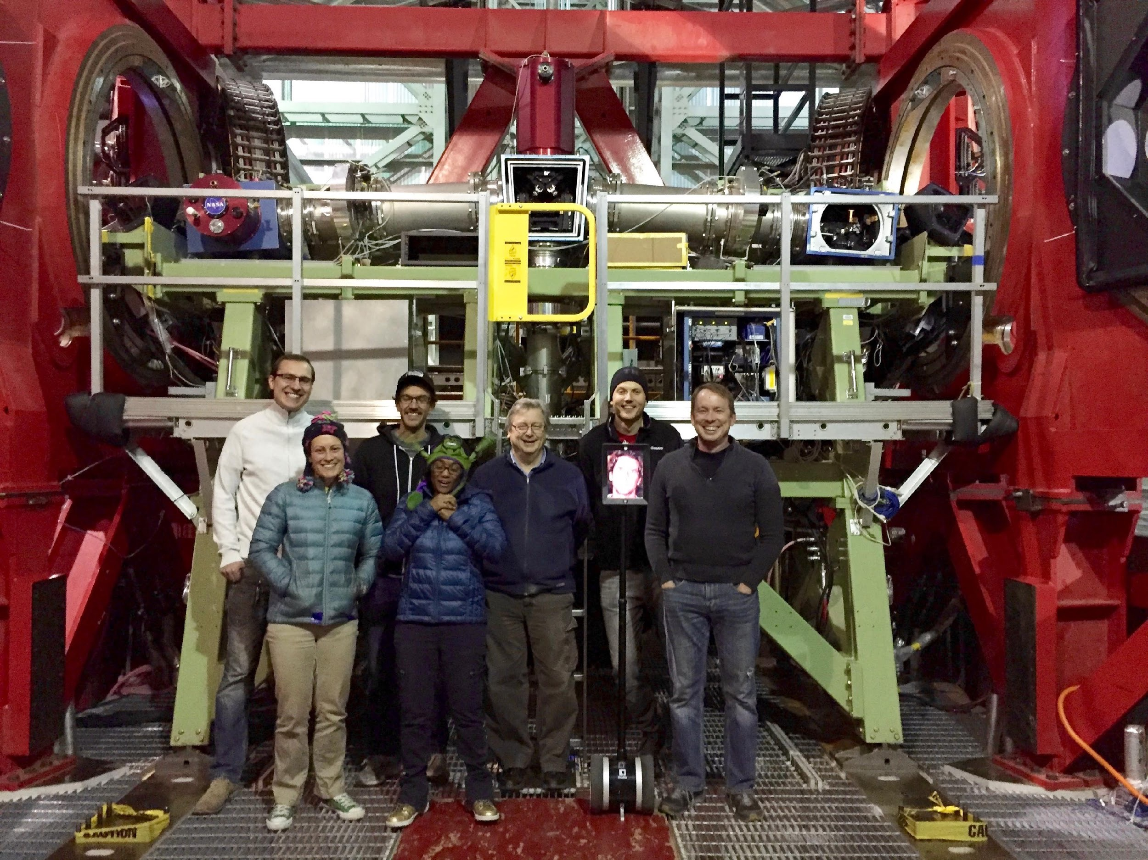
LBTI Team

Slide 8
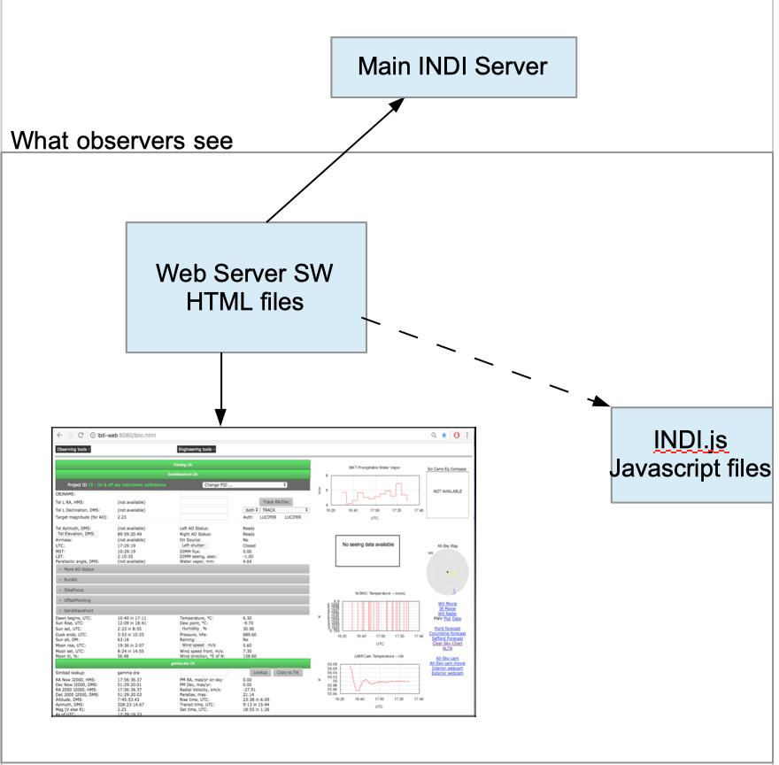
General Software Layout of LBTI site

Slide 9


